Slide 1



Capgemini’s proposal to support Beazley with Test data and Environment management solution

Slide 2
TOPICS
A. Test data management:
1
Our understanding – Current limitations
2
Solution architecture – GPAS and Extendable beyond GPAS
3
E2E Test data flow – GPAS context
4
Roadmap and Commercials
B. Test environment management:
1
Current state of play, what environments are availale
2
Beazley needs (R5, R6)
3
Next steps – understand expectations, Controls and process

Slide 3
Test Data Management – Current limitations
Key Requirements | Current limitations
Reference data | Reference data is not synchronized across integrated systems. For example, the same broker information should be consistently available in both Insight and CRM for new submissions.
Synthetic Data Creation | Currently at Beazley, there is no mechanism to generate a diverse range of test data.
Data orchestration | No solution to enable test data in an event driven architecture. Directly inserting data in the Databases is not an appropriate in this architecture
Data obfuscation | Currently at Beazley, there is no mechanism to obfuscate production data for use in lower environments
Data reconciliation | Due to asynchronous communication, data reconciliation has become challenging. There is currently no approach to track data across each hop and verify alignment with the source system
Data storage and Reuse | There is no centralized data source that can be referenced; each system maintains its own data, leading to challenges with data synchronization
Test data on demand | There is currently no mechanism to provision on-demand test data for unit, integration, or system testing. Most teams manually create and use their own data for testing purposes
Solutions for core platform | No single solution. There may be isolated solutions within a platform / project
Non availability of integration system to provision data | Except for GPAS, all other systems have only two environments—Dev and SIT or Dev and UAT. As a result, there is no one-to-one mapping between upstream and downstream systems.

Slide 4
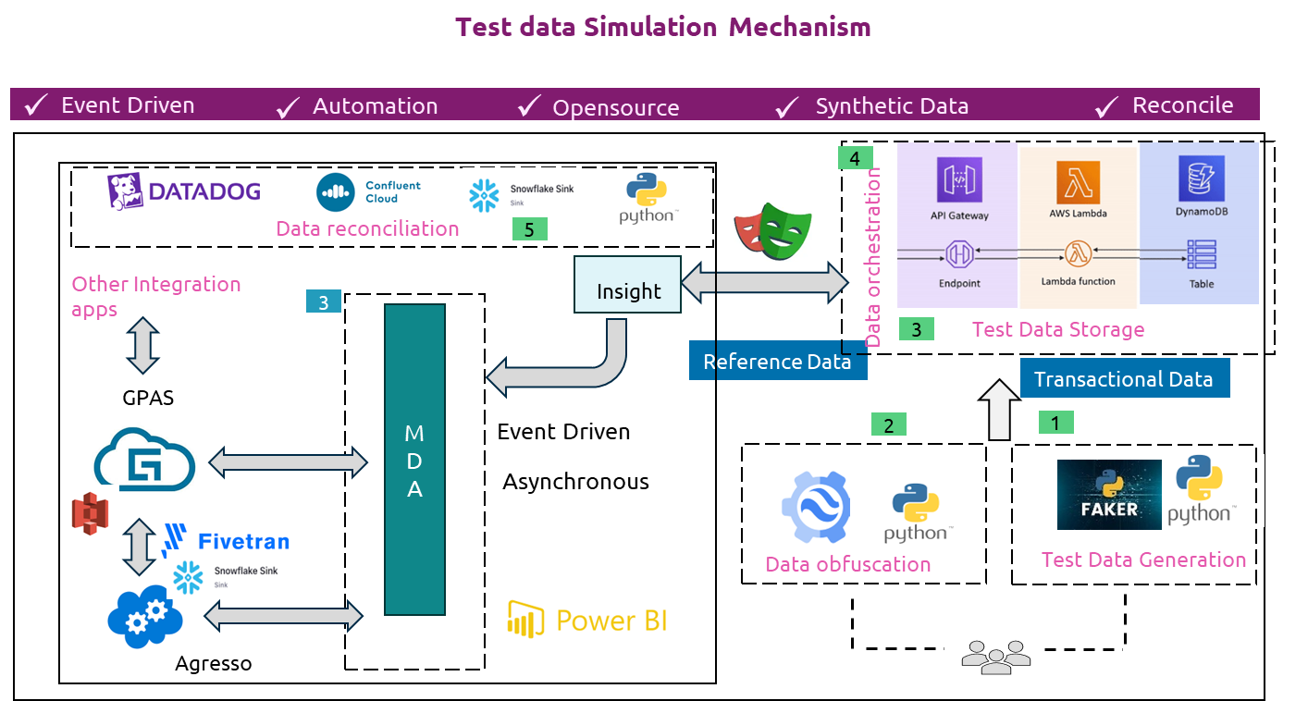
Test Data Management – Solution architecture
Solution Key Features
Reference Data Requirement– Engage with multiple teams to gain access to critical applications (Insight, UWWB, MDA, GPAS) and understand data dependency, flow mechanisms, including trigger-based data propagation
Synthetic Test Data generation using Python faker package, create directly into DynamoDB.
Event-Driven Architecture require data insertion via GUI. Trigger event to get data set and insert into source app using playwright or any other tool
Reconcile: Asynchronous communication between systems, utilised different tools to reconcile the data
[Refer arch diagram for TDM considerations]
Test Data Generation: Python faker to create test data
Data obfuscation replace
Test data storage
Data Orchestration
Data Reconciliation

Slide 5
Test Data Management and Reconciliation – GPAS data flow
Key Principles
Data ingestion at source
Aligned to event driven arch.
ü
ü
Synthetic test data
ü
Automation
ü
Data integrity
ü
Reconciliation
Automated
Synthetic Test Data Creation
1
2
Insight/UWWB
3
4
GW Integration Gateway
5
Guidewire (PC / BC)
Amazon
DynamoDB or similar
MDA
Pre-Requisite
Reference Test Data
8
7
6
Orchestration options:
A. Get/update/delete via API: Any system to make API call to get required test data
B. DB Connection
Test Data Generation tool – Generate synthetic data and publish on DynamoDB
Transform data from DynamoDB in required structure / format for ingestion in application
MDA consumes data processed in source system and enriches the data
Bind event / Submission published on Kafka topic for Guidewire (GW) integration gateway
Guidewire Policy Center consumes data from GW Integration gateway
Guidewire Bind success message sent to GW integration gateway
GW integration Gateway publish data on MDA
UWWB/Insight consume from MDA
Agresso workflow
A. GW integration to CDA replication
B. Fivetran to pull the data and send to Snowflake
C. Snowflake to Agresso
CDA
MDA-Snowflake
Agresso
A
B
C
Validation of the approach – Proof of concept
Created synthetic test data
Reference data setup (Org, Producer) – MDM, CRM
Used Playwright to structure the payload
Ingest data into Guidewire API
Bind and Issue > Billing Centre > CDA
Data successful loaded in Snowflake for finance
Reconciliation
Confluent control center, Datadog, S3 bucket, Snowflake dashboard to reconcile record counts

Slide 6
Roadmap and Commercials
4 months projected
Due diligence, GPAS base setup and POC
GPAS Implementation
And relevance to other Applications
Overall Beazley TDM Assessment
Solution definition
Rollout approach
Setup preparation
Reference Data implementation
Synthetic data implementation
Data Obfuscation implementation
End to end integration
Verification
Data governance
Adaption of the process based on learning from GPAS implementation
Holistic solution for the wider landscape
Baseline the process, use of tools, TDM governance, Ownership
Review (R5, R6) requirements and remediation
Document review and approve the TDM Solution
Conduct sessions, provide documents to value streams about the solution for the respective teams to implement in their area
Current State Analysis
Reference Data Requirements
Synthetic data creation
Proof of Concept for data creation, orchestration
Test Architect on T&M basis for the planned work / duration: £138,580
Approx. 30 – 40% effort in total could be to provide GPAS test data solution
After review and analysis of the Beazley needs (R5, R6) requirements, there may be need to get an offshore engineer to work with test architect for a duration on T&M basis and will be priced separately.

Slide 7
Test Environment Management

Slide 8
GPAS Integration Test Environment Mapping
Work in progress
Environment | Sprint Test | E2E/SIT | NFT, PERFFORMANCE | UAT
Guidewire – PC/BC | ✅SIT | ✅ TEST | ✅NFT | ✅Performance | ✅UAT
Insight | ✅ INT | ✅ UAT | ❌ | ❌
UWWB | ✅Dev | ✅ TST | ❌ | ❌
MDA | ✅Dev | ✅ TST | ❌ | ❌
CRM | ✅ Dev | ✅ SIT | ❌ | ✅ UAT
MDM | ✅Dev | ✅ TST | ❌ | ❌
Agresso | ✅Dev | ✅ UAT | ❌ | ❌
HX | NA | ✅ TST | ❌ | ❌
GRS | NA | ✅ TST | ❌ | ❌
PowerBI | Tbc | ✅ TST | ❌ | ✅ TST
Appian | Tbc | Tbc | Tbc | Tbc
Agresso-Finance | ✅Dev | ✅ TST | ❌ | ❌
Policy Combined | ✅Dev | ✅ TST | ❌ | ❌
Finance | ✅Dev | ✅ TST | ❌ | ❌
Account Receivable | ✅Dev | ✅ TST | ❌ | ❌
Cash Data Product | ✅Dev | ✅ TST | ❌ | ❌
Beazley Intelligence | Tbc | Tbc | Tbc | Tbc
Policy Retrieve | Tbc | Tbc | Tbc | Tbc
FX Service | Tbc | Tbc | Tbc | Tbc

Slide 9
Test Environment Solution To Address Beazley Requirements
R5 - Coordinate environment usage and optimise costs but reinforcing environment management and lifecycle practices (FinOps)
R6 - Implement a test environment and data strategy, supporting the provision and implementation of appropriate tooling to support test data needs.
R6 - Implement a test data strategy, extending Test Data Management capabilities across Beazley, including Modernisation.
R6 - Implement a test environment strategy, extending Test Environment Management capabilities across Beazley, including Modernisation.
R6 - Implement a test environment and data strategy and align new and existing test approaches.
R6 - Implement a test environment and data strategy, increasign awareness and understanding of data management policies and processes through both induction and training, along with supporting documentation, including governance
R6 - Implement a test environment and data strategy, ensuring alignment with IT security policies and standards and adherance to legal and regulatory compliance requirements.

